Slide 1
INFORMATION SECURITY [3 0 0 3] ICT 3172:

Slide 2
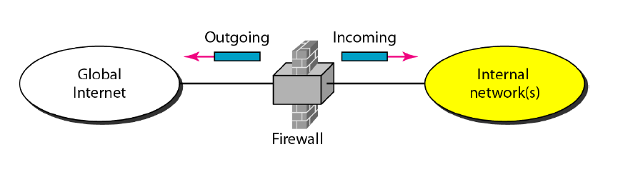
Firewall
A firewall is a device installed between the internal network of an organization and the rest of the Internet.
It is designed to forward some packets and filter (not forward) others.
Firewall configured between trusted and untrusted boundaries (Zones)
Main scope is to control traffic coming from untrusted Zone (internet)
.

Slide 3
Firewall
A firewall is a set of related programs, located at a network gateway server, that protects the resources of a private network from users from other networks.
System designed to prevent unauthorized access to or from a private network
Will check messages entering and leaving and block those that do not meet the specified security criteria
Considered the first line of defense in protecting private information
Can be Hardware or Software
.

Slide 4
Need for Firewall
Internal network and hosts are unlikely to be properly secured.
Internet is a dangerous place with criminals, users from competing companies, disgruntled ex-employees, spies from unfriendly countries etc.
To prevent an attacker from launching denial of service attacks on network resource.
To prevent illegal modification/access to internal data by an outside attacker.
.

Slide 5
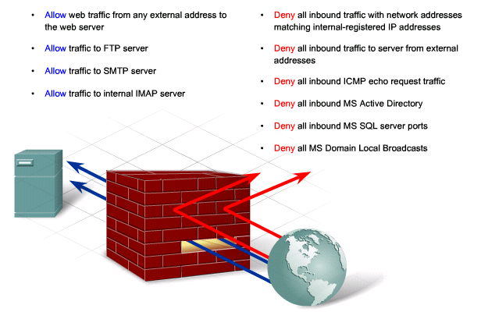
Firewall
.

Slide 6
Firewall
A firewall is a hardware or software (or a combination of hardware and software) that monitors the transmission of packets of digital information that attempt to pass through the perimeter of a network.
It is an effective means of protecting a local system or n/w from n/w related security threats
.

Slide 7
Firewall design goals
All traffic from inside or outside must pass through the firewall
Only authorized traffic as defined by the local security policy, will be allowed to pass
The firewall itself is immune to penetration
.

Slide 8
Four general techniques that firewalls use to control access and enforce the site’s security policy. Originally, firewalls focused primarily on service control, but they have since evolved to provide all four:
Service control: Determines the types of Internet services that can be accessed, inbound or outbound. The firewall may filter traffic on the basis of IP address, protocol, or port number; may provide proxy software that receives and interprets each service request before passing it on;
Direction control: Determines the direction in which particular service requests may be initiated and allowed to flow through the firewall.
User control: Controls access to a service according to which user is attempting to access it. This feature is typically applied to users inside the firewall perimeter (local users). It may also be applied to incoming traffic from external users; the latter requires some form of secure authentication technology.
Behavior control: Controls how particular services are used. For example, the firewall may filter e-mail to eliminate spam, or it may enable external access to only a portion of the information on a local Web server.
.

Slide 9
The following capabilities are within the scope of a firewall:
1. A firewall defines a single choke point that keeps unauthorized users out of the protected network, prohibits potentially vulnerable services from entering or leaving the network.
2. A firewall provides a location for monitoring security-related events. Audits and alarms can be implemented on the firewall system.
3. A firewall is a convenient platform for several Internet functions that are not security related. These include a network address translator, which maps local addresses to Internet addresses, and a network management function that audits or logs Internet usage.
4. A firewall can serve as the platform for IPsec. Using the tunnel mode capability, the firewall can be used to implement virtual private networks.
.

Slide 10
Firewalls have their limitations, including the following:
The firewall cannot protect against attacks that bypass the firewall.
2. The firewall may not protect fully against internal threats, such as a disgruntled employee or an employee who unwittingly cooperates with an external attacker.
3. An improperly secured wireless LAN may be accessed from outside the organization. An internal firewall that separates portions of an enterprise network cannot guard against wireless communications between local systems on different sides of the internal firewall.
4. A laptop, PDA, or portable storage device may be used and infected outside the corporate network, and then attached and used internally.
.

Slide 11
TYPES OF FIREWALL
• A firewall may act as a packet filter. It can operate as a positive filter, allowing to pass only packets that meet specific criteria, or as a negative filter, rejecting any packet that meets certain criteria.
• Depending on the type of firewall, it may examine one or more protocol headers in each packet, the payload of each packet, or the pattern generated by a sequence of packets.
The types of firewalls are.
Packet Filters
Application-Level Gateways
Circuit-Level Gateways
.

Slide 12
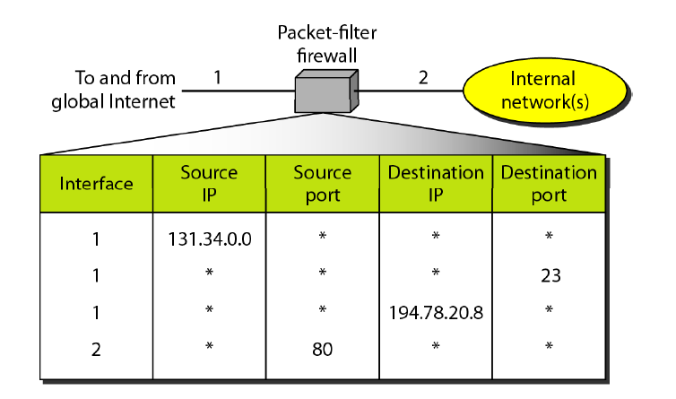
Packet Filtering
A packet filtering firewall applies a set of rules to each incoming and outgoing IP packet and then forwards or discards the packet.
Filtering rules are based on information contained in a network packet:
Generally accomplished by configuring Access Control List (ACL) on Routers, Switches.
ACL is a table of packet filter rules.
Allows or block packets based on:
Source and/or destination IP address.
Protocol
Source and/or destination port numbers
And various other parameters within the IP header.
Packet filtering can be stateless or stateful.
.

Slide 13
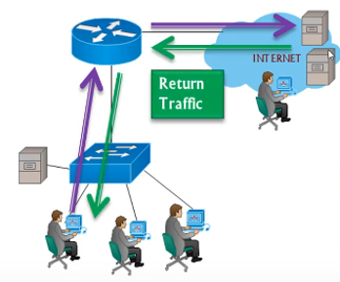
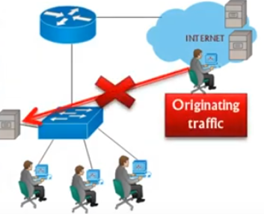
Stateful Packet Inspection
Allows connection originating from hosts on inside (trusted) interface.
Drops connection attempts originating from hosts on outside(untrusted) interfaces.
Monitors the state of active connections.
Use this information to determine which network packets to allow through the firewall.
.

Slide 14
Stateless Packet filtering
Evaluate packet contents statically and does not keep track of the state of network connections.
Allows or block packets only based on:
Source and/or destination IP address.
Protocol
Source and/or destination port numbers
And various other parameters within the IP header.
.

Slide 15
Packet filtering Firewall
.

Slide 16
Packet filtering Firewall
Attacks on Packet Filters
IP address spoofing
fake source address (internal)
add filters on router to block (external interface)
source routing attacks
attacker sets a route other than default
block source routed packets
tiny fragment attacks
split header info over several tiny packets
either discard or reassemble before check
.

Slide 17
Packet filtering Firewall
Advantages
Simple
Transparent to users
Very fast
Disadvantages
Rule generation is difficult
Lack of authentication
.

Slide 18
Application Level Gateway
An application-level gateway, also called an application proxy, acts as a relay of application-level traffic.
The user contacts the gateway using a TCP/IP application, such as Telnet or FTP, and the gateway asks the user for the name of the remote host to be accessed.
When the user responds and provides a valid user ID and authentication information, the gateway contacts the application on the remote host and relays TCP segments containing the application data between the two endpoints.
Rather than trying to deal with the numerous possible combinations that are to be allowed and forbidden at the TCP and IP level, the application-level gateway need only scrutinize a few allowable applications.
.

Slide 19
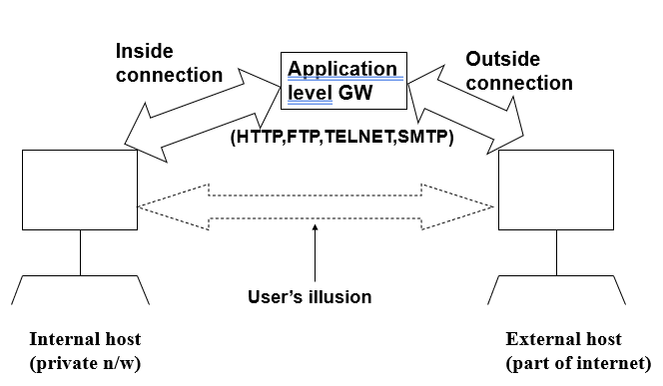
Application Level Gateway
.

Slide 20
Application Level Gateway
Purpose
- monitor every connection
- provide end-to-end connection
Advantage
- more secure than packet filter
Disadvantage
Additional processing overhead on each connections
.

Slide 21
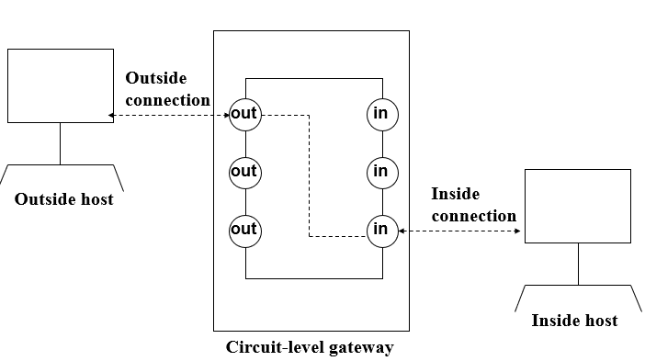
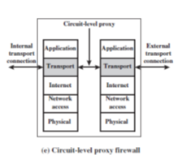
Circuit Level Gateway
This can be a stand-alone system or it can be a specialized function performed by an application-level gateway for certain applications.
Relays two TCP connections
Imposes security by limiting which such connections are allowed
Once created usually relays traffic without examining contents
Typically used when trust internal users by allowing general outbound connections
.

Slide 22
Circuit Level Gateway
Unlike application gateway, a circuit-level gateway does not permit an end-to-end TCP connection; rather, the gateway sets up two TCP connections, one between itself and a TCP user on an inner host and one between itself and a TCP user on an outside host.
Once the two connections are established, the gateway typically relays TCP segments from one connection to the other without examining the contents. The security function consists of determining which connections will be allowed.
A typical use of circuit-level gateways is a situation in which the system administrator trusts the internal users.
In this configuration, the gateway can incur the processing overhead of examining incoming application data for forbidden functions but does not incur that overhead on outgoing data.
An example of a circuit-level gateway implementation is the SOCKS package ; version 5 of SOCKS is specified in RFC 1928.
.

Slide 23
Common Misconceptions of Firewalls
A firewall is always a hardware
A firewall can protect you from all possible threats
A firewall protects all possible Information
A firewall can protect you from a completely new threat
.

Slide 24
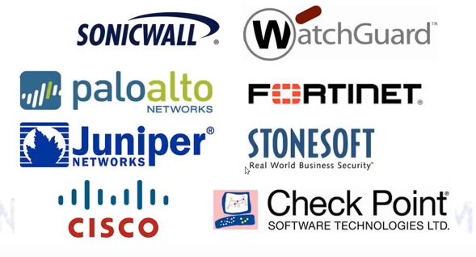
Popular Firewall Vendors
.

Slide 25
Intrusion Detection System (IDS)
Intrusion Prevention System (IPS)
.

Slide 26
IDS
Intruder :
Attacker who attempt to breach the security of the network.
Attacker who is trying to gain an unauthorized access to the system or network with criminal intension.
Intrusion : unauthorized access to the network or the system.
IDS: Device which detects the intrusion.
IDS monitors the process of events occurring in systems.
Intrusion Prevention is the process of detecting the signs of intrusion and to stop the intrusive efforts.
Collectively referred as IDPS.
.
Notes:
i

Slide 27
Intruders classification
Masquerader:
outsiders from trusted users and are not authorized to use the computer systems.
An unauthorized person uses our system and exploit legitimate users account.
Misfeasor:
Insiders, authorized, misuses their privileges.
Legitimate users only but no authorization. Even if authorized, even if authorized he/she will misuse the privileges.
Clandestine users:
both insiders & outsiders, gains supervisory access to systems.
A person who takes the supreme control of the system and stops access to legitimate user.
.

Slide 28
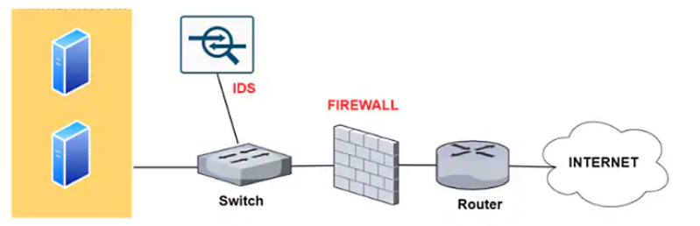
Intrusion Detection System
It Continuously monitors the network and check for any malicious content is in the network.
If any intrusion is detected, IDS send the alert system admin to take necessary action
.

Slide 29
Types of IDS technologies
Network Based: monitors network traffic for network segments. Analyzes network/application protocol activity to identify suspicious activity.
Wireless : Analyzes wireless protocols for suspicious activity.
Network behavior analysis
Host based
.

Slide 30
Types of IDS technologies
Network Based Intrusion Detection Systems (NIDS):
Network based
Analysis: Matches traffic to the library of known attack
Monitors, capture and analyze network traffic
Detects malicious data present in the packet.
Analysis is very difficult in busy network
.

Slide 31
Types of IDS technologies
Host based Intrusion Detection System (HIDS)
Host based
Installed on individual host or device on network
Monitors data packets from the device only and will alert the admin if suspicious activity is detected.
Initially takes the snapshot of the clean system. Later takes the snapshot of the existing system and compares with the clean system.
Files deleted or modified.
.

Slide 32
Uses of IDS
Identify security policy problems
Documenting the existing threat to an organization
Deterring individuals from violating security policies
Preventive actions of the IDPS
.

Slide 33
ID techniques
Signature based
Anomaly based
Stateful Protocol analysis
.

Slide 34
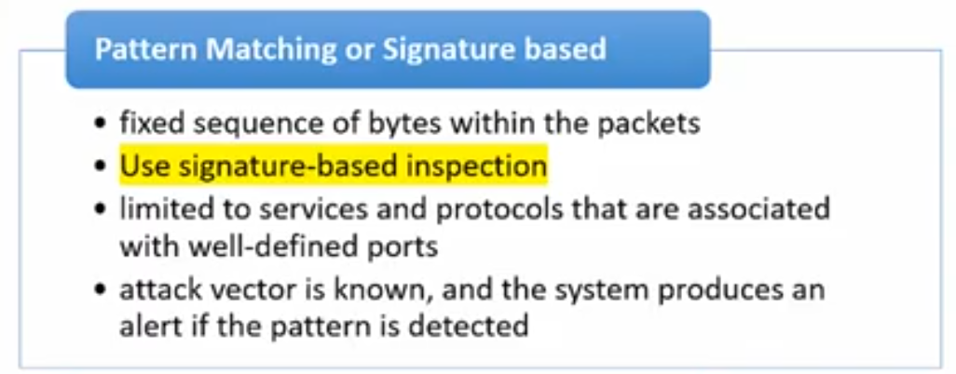
ID techniques
Signature based
Pattern
Database of attack pattern.
Detect know attack
Cannot identify new attack
.

Slide 35
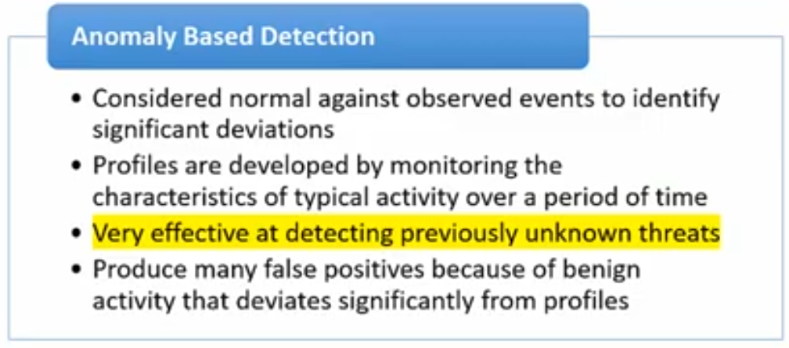
ID techniques
Anamoly based :
Deviation from the baseline behavior.
.

Slide 36
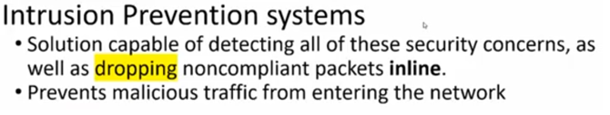
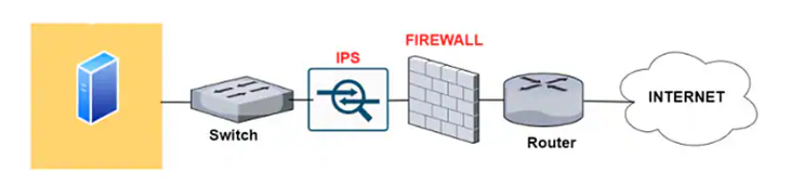
Intrusion Prevention System
.

Slide 37
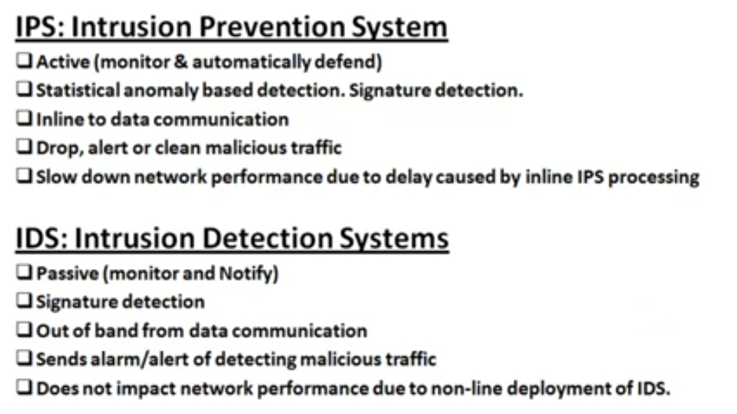
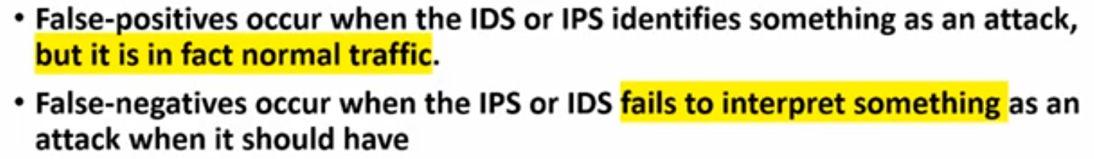
Difference between IDS and IPS
.

Slide 38
END
.

